Slide 1

DriverPass System Analysis
Ricardo Reyes
Notes:
[No speaker notes required for this slide.]

Slide 2

System Requirements
Functional Requirements:
Registration and login user.
DMV access for updates on policies, and other DMV changes.
Nonfunctional Requirements:
A database is required, storage, and web app data.
User access to profile and ability to update and make changes to the profile.
Notes:
DrivePass has many requirements for it to work. These are some of the more important requirements.
As for functional requirements, the user will require registration and the ability to login. The system will also require access to the DMV database, for any updates and changes in policies or any other rules.
For nonfunctional requirements, A database will be required to keep everything organized there will be a storage required for the database, and any other web app data. Users need access to their profile and the ability to make any changes to their profile. This should include changing their password, address, etc.

Slide 3
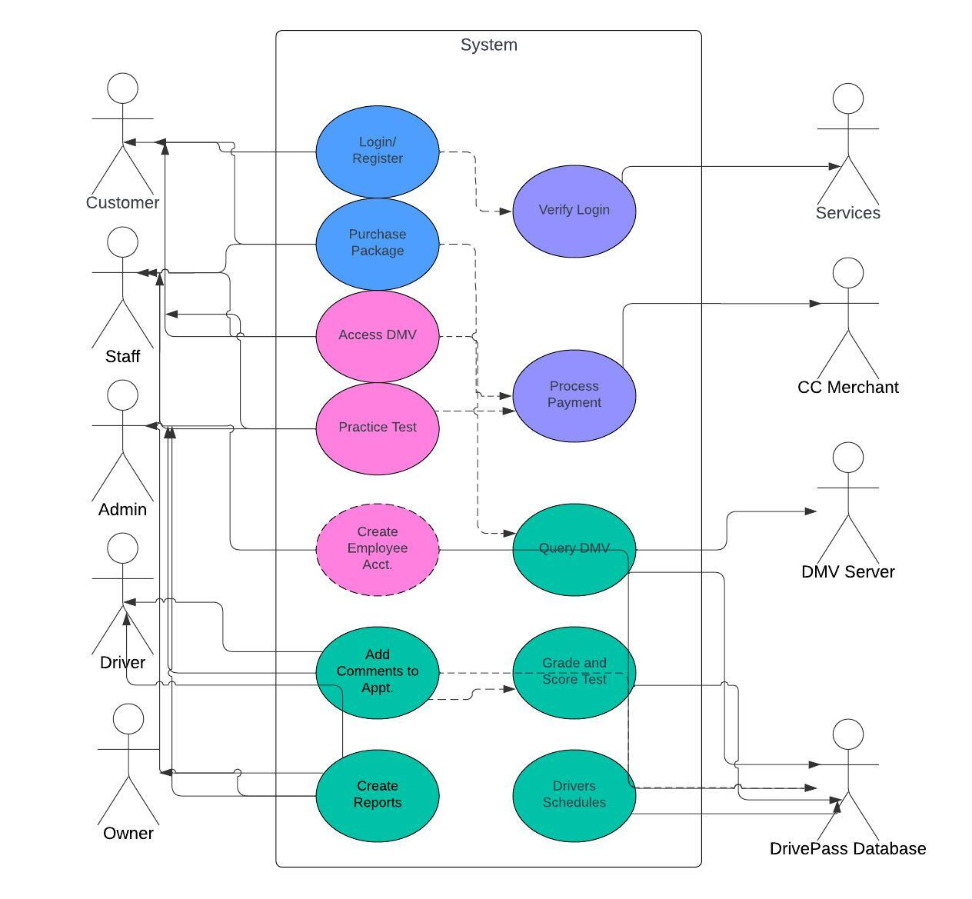
Use Case Diagram
Notes:
The diagram shows the different connections from each actor to each part of the system. The customer has access to the login, package purchases and practice test. The staff have access to the DMV database they can see the purchase packages. The admin has access to almost every part of the system. The driver can add comments and create reports. The services would be the login verification the purchasing gets verified by the merchant the DMV database is controlled by the DMV Server and the DrivePass database.

Slide 4
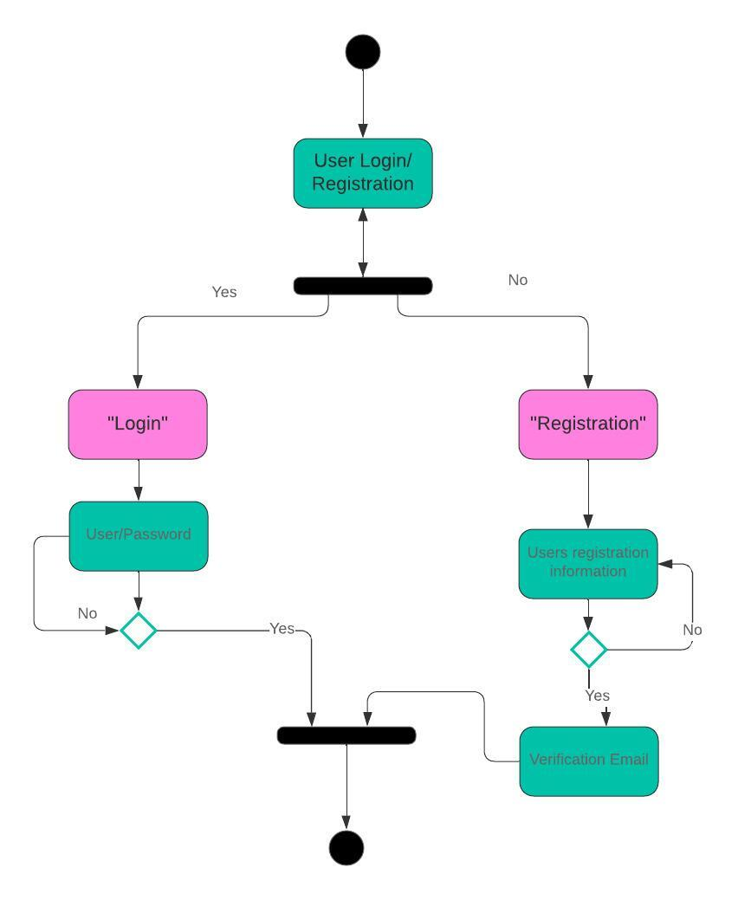
Activity Diagram
Notes:
This log breaks down information from the use case diagram. The user logs in if the user is new, they’ll need to register if they are a return user the login. This is followed by the authentication or collection of the users information. After that the user is either logged in or will require to confirm a verification email.

Slide 5
Security
Authentication will be required for the user's email.
The convention of login in with a user and password.
A two-step verification, to reduce hacking or any other malicious access.
Use of convectional HTTPS to strengthen the security with encryption.
Notes:
You have to start with the basics and most common conventions. User/Password, Authentication or verification of email, adding those extra layers of security such as two-step verification and HTTPS.

Slide 6
System Limitations
Depending on location and demographics, web apps will load at different speed for different users.
There is no way for the client to troubleshoot if errors occur.
Though the goal is to be able to be accessed by all devices. Depending on the OS some device might not be up to date to be able to use the web app.
Notes:
[What are the limitations of your design? In your explanation, keep your audience in mind by avoiding the use of technical terms.]

